Slide 1
Demand Forecast
1. Scope & Objectives
2. Key Findings
3. Prediction Results
4. Recommendations

Slide 2
Scope & Objectives
Problem Definition
Loading excess cash in ATMs, rather than only loading in what the demand roughly is, increases operational and opportunity costs.
Conversely, if there is not enough cash loaded into ATMs, there will be “out of cash” transactions, resulting in the bank’s reputation being damaged, as well as lowered income and customer satisfaction.
Solution
Build a process capable of identifying patterns in customer past behavior in order to estimate future demand
Four new ATMs have been installed in the new region
The data in hand are in essence time series, data with an everyday snapshot
From now on and until the end of this presentation the below are defined as follows:
BN_20: remaining amount in bill notes of 20 euros.
BN_50: remaining amount in bill notes of 50 euros
Cash Out: displays the cumulative total of the amount withdrawn
Remaining Amount: amount available for cash-out.
Status: ATM service status (up/down).
Datetime: date and time values were recorded.

Slide 3
Demand Forecast
1. Scope & Objectives
2. Key Findings
3. Prediction Results
4. Recommendations

Slide 4
Key Findings - Dataset
Whenever there are erroneous data (double timestamps for same ATM, the one with the highest withdrawal is kept.
Data are captured only on weekdays meaning Monday depicts collective withdrawal from Saturday, Sunday & Monday.
Depending on the ATM data are being captured once a day or twice a day, at 8:00 AM and/or 8:00 PM respectively
Four different ATMs for which the analysis has run.
Each ATM runs for different periods of time:
ATM #1: 2 month of data (Feb 2022- April 2022)
ATM #2: 26 month of data (Feb 2020- April 2022)
ATM #3: 22 month of data (Jun 2020- April 2022)
ATM #4: 26 month of data (Feb 2020- April 2022)
BN_20 | BN_50 | Cash Out | Remaining Amount | Status | Datetime
19880 | 49150 | 970 | 69030 | UP | 2/18/2022 8:00
19740 | 49050 | 1210 | 68790 | UP | 2/21/2022 8:00
19720 | 49050 | 1230 | 68770 | UP | 2/22/2022 8:00
19640 | 48950 | 1410 | 68590 | UP | 2/23/2022 8:00
19640 | 48350 | 2010 | 67990 | UP | 2/24/2022 8:00
19640 | 45850 | 4510 | 65490 | UP | 2/25/2022 8:00
19460 | 43250 | 7290 | 62710 | UP | 2/28/2022 8:00

Slide 5
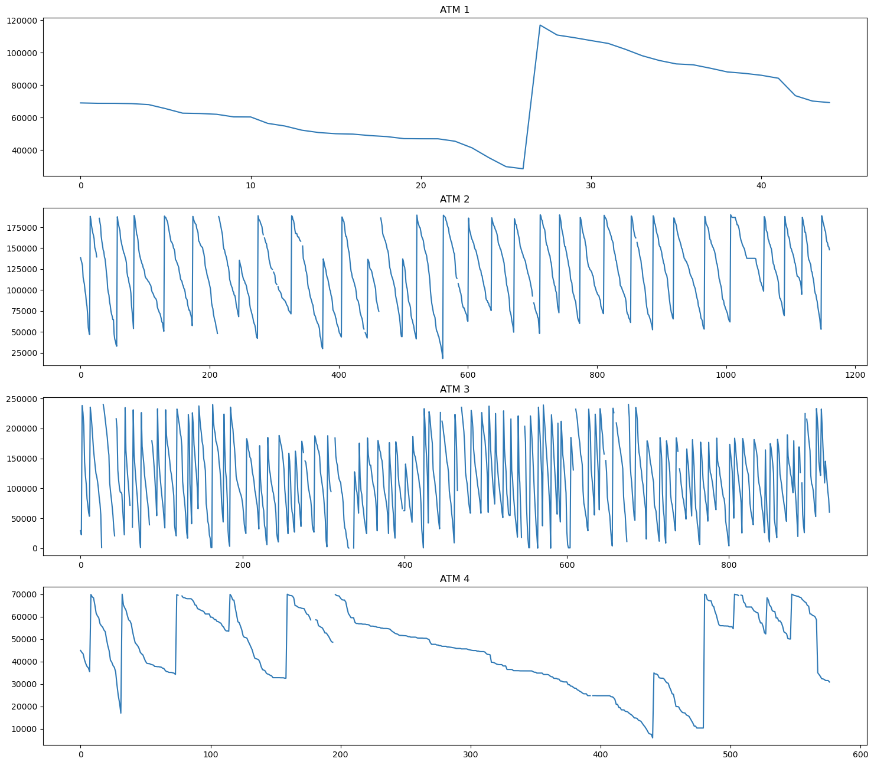
Key Findings – Remaining Amount
All four ATMs show variations with time in the amount remaining.
Positive spikes indicate that a large amount of money has been deposited in the ATM whilst down spikes show how cash is withdrawn with time.
Although there are hints of seasonal factors on those spikes, looking closer shows that there is no constant time window that deposits happen.
The maximum amount that an ATM can hold differs from device to device but also in the same device. Different season can mean different total amount available for withdrawal.
Each time remaining amount increases significantly, cash out counter defaults.
Assumption #1
Cash out amount matches withdrawal amount when a lot of money are deposited in an ATM.

Slide 6
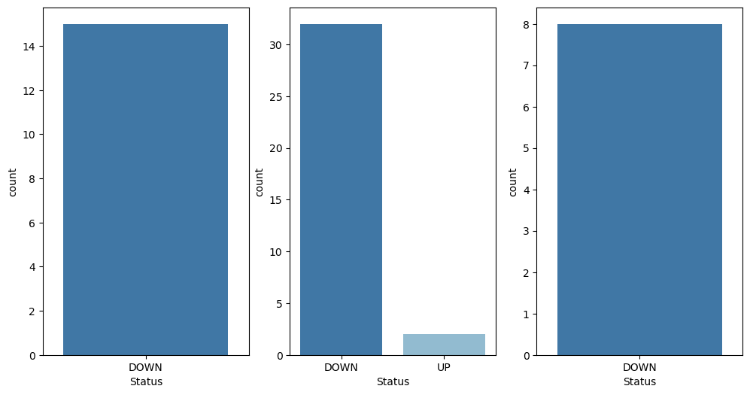
Key Findings – Status
ATMs can have a status of Up or Down based on if they are operative or not.
When they are Down no data are being registered.
When an ATM is down cash out and remaining amount balance, naturally, remains unchanged from previous registered day.
Assumption #2
Whenever no data is captured on a weekday but no malfunction is registered, the ATM is considered as “Down” for that particular time.

Slide 7
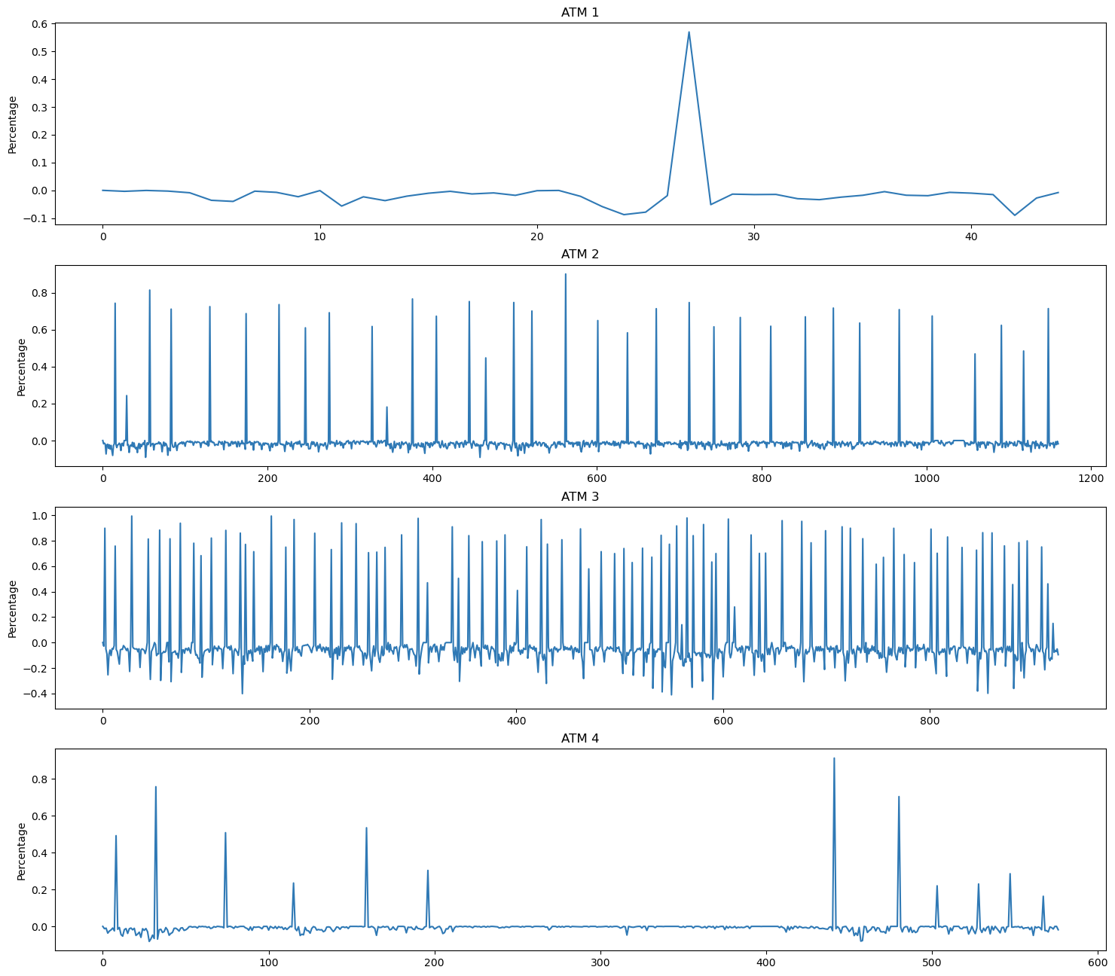
Key Findings – Cash Out
Objective is to deploy a process capable of identifying cash demand for those four ATMs.
Data have been processed and aggregated on a daily basis, from Monday to Friday.
A new feature has been created that depicts the daily cash out instead of cumulative cash out by calculating amount difference in pairs.
As mentioned, max remaining amount varies depending on time and ATM.
The percentage change between two successive points in time can be either positive meaning that withdrawals on that day are more than deposits or negative which indicates the opposite.
Chart on the left shows both huge and smaller spikes, negative or positive.
Assumption #3
Cumulative cash out and in extent daily cash out, do not hold only withdrawals but are actually the balance between withdrawals and deposits. The latter can be deposits from the bank (ATM refills) or customer deposits (where spikes tend to be small and negative).

Slide 8
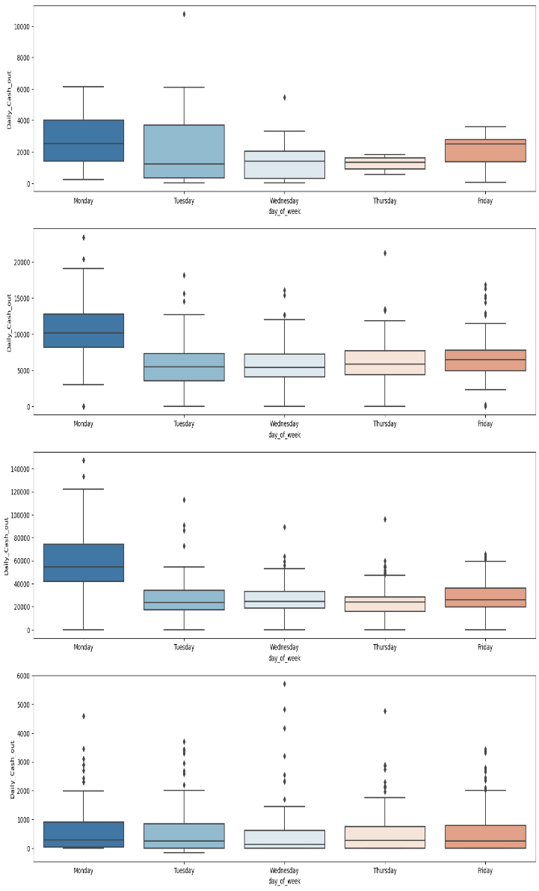
Key Findings – Day of week
Most money are being moved from ATMs on Mondays, a day which also contains the transactions made during the weekend.
Following that, Friday, in some cases, seems to also have a higher positive balance than the other days which makes sense considering that a weekend is incoming.
When it comes to day of month, ATM 2 & 3, have higher cash out amount during the end of that particular month and ATM 1 during the start.

Slide 9
Demand Forecast
1. Scope & Objectives
2. Key Findings
3. Prediction Results
4. Recommendations

Slide 10
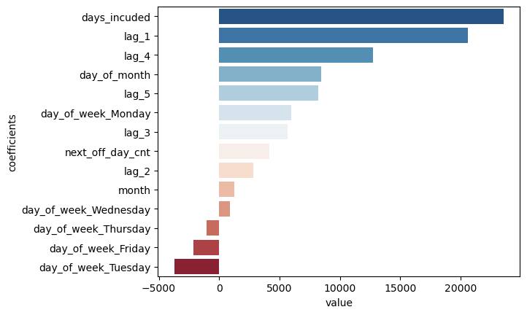
Feature Importance
There has been developed a separate prediction model for each of the four ATMs in hand.
In each and every one of them, it seems, that the most influential factors for predictions are dimensions such days that are report on a specific record, month, day of month and previous days values.
Especially Monday, when it comes to day of week, is an attribute that drives estimations upwards..

Slide 11
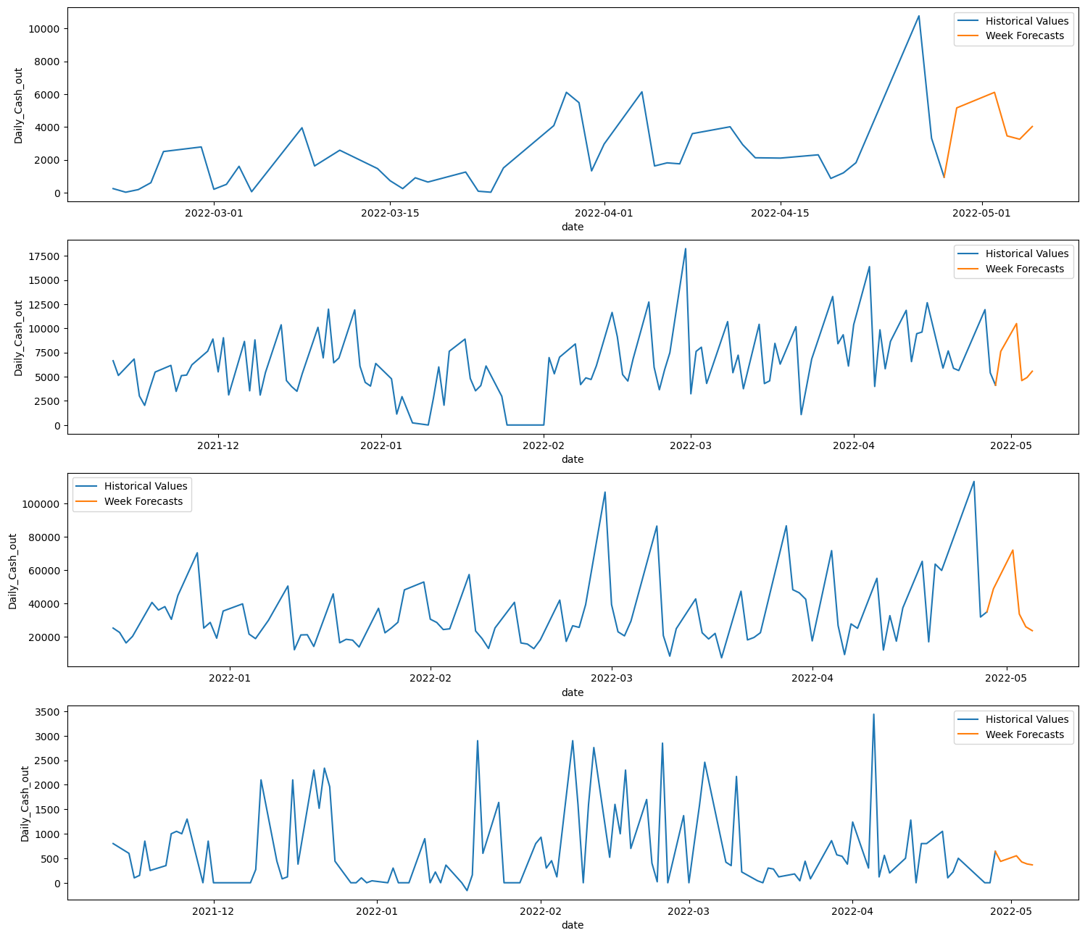
One Week Forecasts
Date | ATM 1 Forecasts | ATM 2 Forecasts | ATM 3 Forecasts | ATM 4 Forecasts
29/04/2022 | 5.160 € | 7.616 € | 48.684 € | 435 €
02/05/2022 | 6.108 € | 10.498 € | 71.965€ | 551 €
03/05/2022 | 3.452 € | 4.597 € | 33.515 € | 425 €
04/05/2022 | 3.250 € | 4.915 € | 25.895 € | 384 €
05/05/2022 | 4.025 € | 5.565 € | 23.541 € | 365 €
RMSE | 1.930 € | 2.837 € | 12.277 € | 841 €
* RMSE: Root Mean Squared Error

Slide 12
Demand Forecast
1. Scope & Objectives
2. Key Findings
3. Prediction Results
4. Recommendations

Slide 13
Recommendations
Research and include more features for all ATMs since prediction capacity is limited for now
When more ATMs are deployed in the new country instead of a model for each, they could be clustered together first and instead build a prediction model for each cluster.
For ATM 4, it is suggested to continue with current processes or use the average cash out value until further enhancements take place.
Indicative features:
Number of transactions
ATM location type (business/public building)
Affluent area (Yes/No)
Area and further location demographics (student area etc)
Competitor distance of ATMs

